Slide 1
527 Data Analytics
Final Project – Group3 (Apple)
Shravan Shankar Polisetty Ezhilarasi Ravichander Abdul Bari Mohammed Shushmitha Anthay Suthakaran Saahil Sofat

Slide 2
Contents
TOPIC | SLIDE NUMBERS
About Apple Inc. | 3-4
About DEF 14A Filing | 5
Part 1: Compensation Table Analysis | 6
Graph – Salary Trend | 6-7
Graph – Stock Awards | 8
Graph – Option Awards | 9
Cumulative Analysis | 10
Stock Trading Activity Analysis | 11-12
Part 2: Intro – Text Analysis | 13
Table & Graph – Word Frequency Distribution | 14
Key Event Indicators | 16
Word Cloud | 17
Plot – Word Correlation Findings | 18 - 20
Conclusion & Future Uses | 21

Slide 3
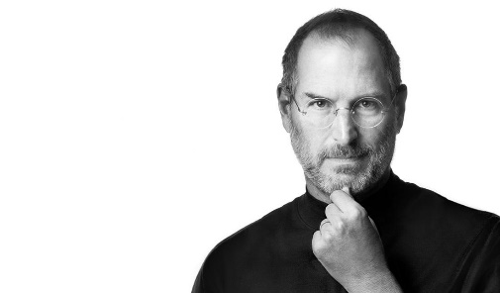
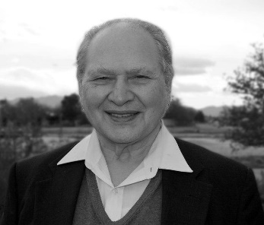
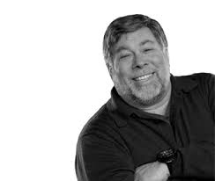
About Apple Inc.
Multinational Corporation
Head Quarters is in Cupertino, California
Founded by Steve Jobs, Steve Wozniak and Ronald Wayne in 1976.
Steve Jobs Ronald Wayne Steve Wozniak

Slide 4
About Apple Inc. (Cont.)
Consumer electronics space
Phones
Tablet
Computer
Media Players
Watches
Apple is the world's largest information technology company by revenue, the world's largest technology company by total assets, and the world's second-largest mobile phone manufacturer.

Slide 5
About DEF 14A Filing
A proxy statement is a statement required of a firm when soliciting shareholder votes.
This statement is filed in advance of the annual meeting.
The firm needs to file a proxy statement, otherwise known as a Form DEF 14A (Definitive Proxy Statement), with the U.S. Securities and Exchange Commission. This statement is useful in assessing how management is paid and potential conflict-of-interest issues with auditors.
The statement includes:
Voting procedure and information.
Background information about the company's nominated directors including relevant history in the company or industry, positions on other corporate boards, and potential conflicts in interest.
Board compensation.
Executive compensation, including salary, bonus, non-equity compensation, stock awards, options, and deferred compensation. Also, information is included about perks such as personal use of company aircraft, travel, and tax gross-ups. Many companies will also include pre-determined payout packages for if an executive leaves the company.
Who is on the audit committee, as well as a breakdown of audit and non-audit fees paid to the auditor.
Apple Inc. has 22 DEF 14 A filings on https://www.sec.gov/ site

Slide 6
Graph – Salary Trend (Apple Inc.)

Slide 7
Graph – Salary Trend (IBM)
There is a drop in the salary for every new CEO that is appointed. It can be seen here in the CEO salary trend for IBM.

Slide 8
Graph - Stock Awards

Slide 9
Graph – Option Awards
Year 1996 in x-Axis is repeated because it includes the data for Michael H.Spindler, former president and CEO and Gilbert F.Amelio ,Chairman of the Board and CEO

Slide 10
Cumulative Analysis
Salary Trend Analysis
Steven P. Jobs – $1 salary as CEO.
We see that the salary of the CEO had a major fall in 1996 followed by the change in the then CEO; Michael H.Spindler to Gilbert F. Amelio. These events can be compared with the fall in stock price in that year(1996), where it reached a low of $23 as seen in the Stock Trade Activity.
Stock Awards Trend Analysis
In the year 2003 Steven P. Jobs was awarded the maximum amount of vested stocks, through his reign as the CEO. The stock price in 2003 was cited at a low of $15 (seen in the Stock Trade Activity), which would have been an opportunity for jobs to purchase maximum market shares.
Option Awards Trend Analysis
In the year 1996, the then CEO, Gilbert F. Amelio was awarded a huge amount of stock options. The stock price in 1996 was cited at a low of $18(seen in the Stock Trade Activity), which would have been an opportunity for him to purchase maximum option awards.

Slide 11
Stock Trading Activity Analysis

Slide 12
Stock Trading Activity Analysis (Cont.)
Intended to find trends in stock price, by recording stock activity, few days before and after DEF 14a filing.
No specific patterns were observed during any filing. Two such examples for the years 2003 and 2014 are portrayed here.
Interesting fact – 1:7 stock split in April, 2014. Drop in stock price from ($647.35 - $93.70)

Slide 13
Intro - Text Analytics
We identified the Q&A Section from the DEF 14A filing over the years (General Information)
Saved these sections to help form a Corpus
Formed a Corpus of these sections using the “TM” package.
Cleaned the Corpus
To Lower Case
Remove Punctuation
Remove Numbers
Remove Default & customized list of stop words. (Ex- the, most, here…)
“GSUB” to remove any unwanted signs and unwanted data
Remove Sparse Terms and Stemming (Optional)
Created a Document Term Matrix
Used “FindFreqTerms” function to find most frequent terms & their counts in the corpus
Understood PATTERNS from these words which helped to make sense of the data.

Slide 14
Table - Word Frequency Distribution
findFreqTerms(dtm[dtm$dimnames$Docs==“Document Name”],2,100)
Year | Frequency
 | 2009 | 2010 | 2011 | 2012 | 2013 | 2014 | 2015 | 2016
annual | 58 | 50 | 52 | 50 | 56 | 66 | 61 | 63
companys | 55 | 63 | 54 | 52 | 68 | 89 | 67 | 60
shareholders | 53 | 46 | 45 | 50 | 50 | 66 | 52 | 54
meeting | 49 | 41 | 41 | 38 | 43 | 54 | 46 | 49
shares | 31 | 35 | 34 | 34 | 37 | 49 | 46 | 52
materials | 31 | 31 | 31 | 30 | 30 | 29 | 31 | 26
proposals | 27 | 33 | 29 | 31 | 19 | 61 | 15 | 14
voting | 20 | 18 | 20 | 20 | 26 | 42 | 33 | 33
notice | 19 | 19 | 18 | 18 | 19 | 19 | 21 | 21

Slide 15
Graph - Word Frequency Distribution

Slide 16
Key Event Indicators
KEI (Frequently Occurring Words):
“annual”, “meeting”, “shares”, “material”, “shareholder”, “voting”, “proposal” and “notice” occur in all filings.
These words can be used for PATTERN Matching to identify filings for Apple Inc..
KEI (Flag Words):
“directors”, “election”, “majority” occur most frequently in the years 2013 and 2014.
Questions include “how to vote?”, “When to vote ?”, “deadlines for voting ?” .
Election was to be held for new board of directors which explains the high usage.
“request” occurs mostly in 2009, 2010, 2011, 2012.
Mostly used in the context of “on request for the printed copy of the proxy document”.
There was decrease in Volume of requests for proxy documents in the following years.

Slide 17
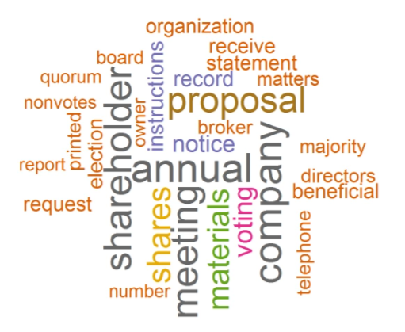
Word Cloud
This word cloud is formed by using a corpus which consists of Q&A sections from multiple DEF -14A filings.
It displays only the most frequently occurring words from the corpus.
17

Slide 18
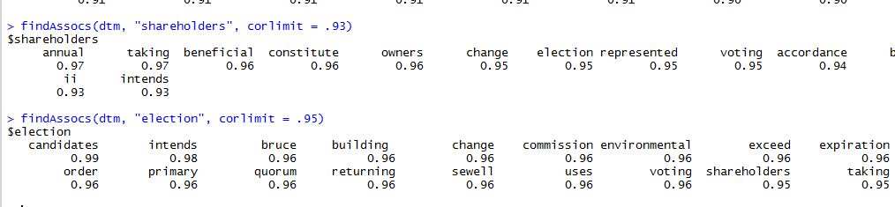
Word Correlations Findings
Used FindAssocs() function and found the word “Shareholders” has a 0.93 relation coefficient with “annual”, ”election”, ”voting”.
Also the vice-versa holds true. “Election” has a 0.95 relation coefficient with “shareholders”.(seen below)
Signifies that words are used in similar context.
Multiple Correlations can be found depending on the objectives.
findAssocs(dtm, “shareholders”, corlimit=0.93)

Slide 19
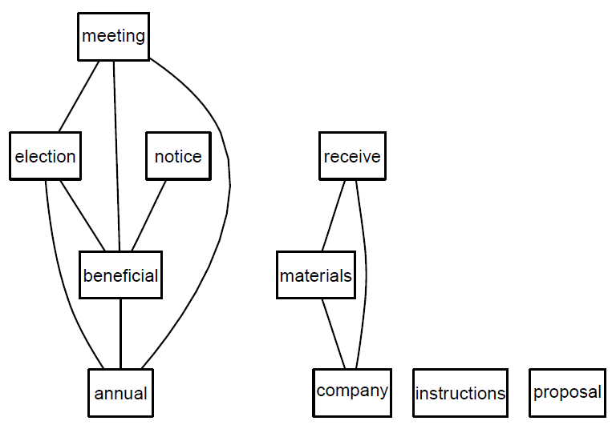
Correlation Plot (Rgraphviz)
plot(dtm,terms=findFreqTerms(dtm, lowfreq=100)[1:8],corThreshold=0.7)
Fig1: Word pattern -Apple, Inc

Slide 20
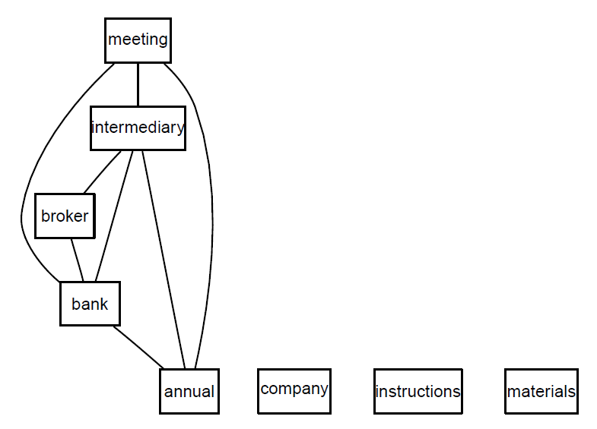
Correlation Plot – IBM
Frequent words
Intermediary
Broker
Bank
Shown in Fig 1
Words which form a pattern for IBM.
Common words across companies.
Company
Instructions
Materials....
Fig 1:Word Pattern - IBM
This shows the
Presence of similar words across companies, referring to similar questions.

Slide 21
Conclusion & Future Uses
Automated the Compensation data from the SEC site, which reduces time and effort.
This Automation can be applied when gathering data, for different requirements.
Understood the CEO compensation details over the history of the company with a click of a button.
Text Analysis also helped understand and make sense of the data without going through it.
Identified word patterns, understood their trends and found possible reasons for it.
Other Uses -
Brand analysis
Marketing analysis
Customer reaction reviews
Used for Intelligence gathering (avoid any terror attacks)

